Slide 1
Generative AI:
Retrieval Augmented
Generation

Slide 2
Learning Outcomes
Upon completion of this session, the learners should be able to:
Explain the what is the Retrieval Augment Generation(RAG).
Apply RAG to solve the real-world use cases across different domains.
Notes:
https://www.slideshare.net/slideshow/generativeaifundamentals-and-large-language-models/265130205#15

Slide 3
Recap of the LLM and Applications
Drawbacks of LLMs
Hallucination
Outdated information
Low efficiency in parameterizing knowledge
Lack of in-depth knowledge in specialized domains
Weak Inferential capabilities
Practical Requirements of Application
Domain-specific accurate answering
Frequent updates of data
Traceability and explainability of generated content
Controllable cost
Privacy protection of data

Slide 4
Symbolic knowledge vs Parametric knowledge
Symbolic Knowledge
Definition: Knowledge stored explicitly in structured, human-readable forms, often rule-based or logic-based.
Examples:
  Knowledge graphs (like Wikidata, Freebase)
  Ontologies (taxonomies, semantic web schemas)
  Formal rules (“If X is a bird → X can fly, unless X is a penguin”)
Characteristics:
  Discrete symbols and relations
  Transparent and interpretable
  Easy to update, but rigid and brittle
Strengths: Good for reasoning, explainability, and enforcing consistency.
Weaknesses: Poor at handling ambiguity, context, or unstructured data like raw text.

Slide 5
Symbolic knowledge vs Parametric knowledge
Parametric Knowledge
Definition: Knowledge encoded in the parameters (weights) of a machine learning model, especially neural networks like transformers.
Examples:
  What GPT knows about world facts (e.g., "Paris is the capital of France")
  Grammar, style, and reasoning patterns that emerge from training
Characteristics:
  Distributed and implicit
  Emerges statistically from large-scale data
  Hard to explicitly modify individual facts
Strengths: Flexible, good at handling noisy, ambiguous, and unstructured inputs.
Weaknesses: Hard to update specific knowledge without retraining (e.g., changing "Twitter" → "X" can require fine-tuning or external memory).

Slide 6
Symbolic knowledge vs Parametric knowledge
Analogy
Symbolic knowledge = a library with labeled books and rules (clear but inflexible).
Parametric knowledge = the brain of a well-read person (intuitive but fuzzy).
The best LLM systems = a person with both a strong memory and access to a library.

Slide 7
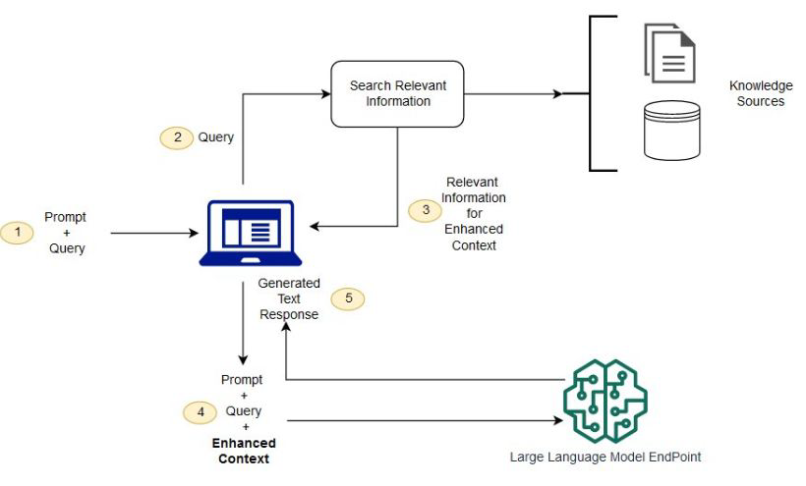
Retrieval Augmented Generation (RAG)
When answering questions or generating text, it first retrieves relevant information from a large number of documents, and then LLMs generates answers based on this information.
By attaching an external knowledge base, there is no need to retrain the entire large model for each specific task.
The RAG model is especially suitable for knowledge-intensive
source: https://aws.amazon.com/what-is/retrieval-augmented-generation/

Slide 8
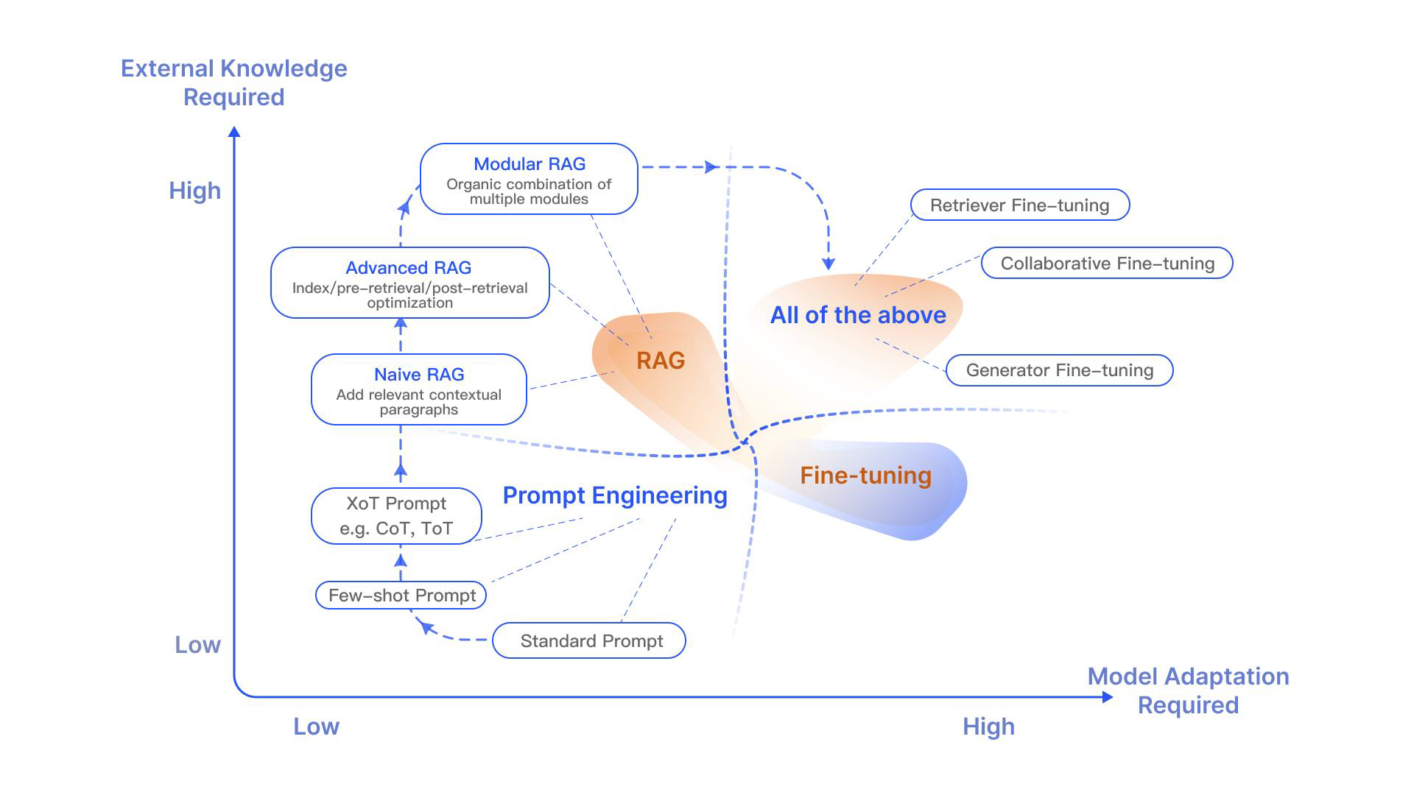
Ways to optimize LLMs
Prompt Engineering
Retrieval Augmented Generation
Instruct/Fine-Tuning

Slide 9
RAG Applications
Scenarios where RAG is applicable:
Long-tail distribution of data
Frequent Knowledge updates
Answer requiring verification and traceability
Specialized domain knowledge
Data privacy preservation

Slide 10
Naïve RAG
Step1 Indexing
1. Divide the document into even chunks, each chunk being a piece of the original text.
2. Using the encoding model to generate an embedding for each chunk.
3. Store the Embedding of each block in the vector database.
Step2 Retrieval
Retrieve the k most relevant documents using vector similarity search.
Step3 Generation
The original query and the retrieved text are combined and input into a LLM to get the final answer

Slide 11
Performance issues with Naïve RAG
Bad Retrieval
Low precision: not all retrieved chunks are relevant
  Hallucination + Wrong replies
Low recall: not all relevant chunks are retrieved
  Lacks enough context for LLM to synthesize the answer
Outdated information: the knowledge base is out of date
Bad Response Generation (Native LLM Issues)
Hallucination: Model makes up an answer that isn’t in the context
Irrelevance: Model makes up an answer that does not answer the question
Toxicity/Bias: Model makes up an answer that is offensive

Slide 12
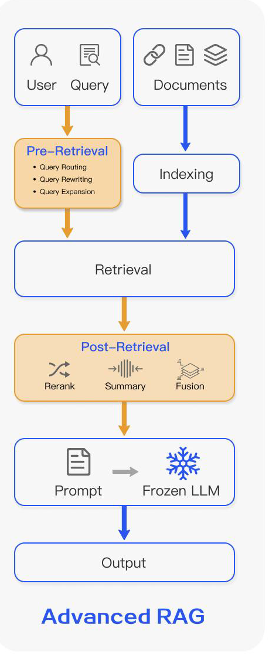
Advanced RAG
Index Optimization ->Pre-Retrieval Process ->Retrieval ->Post-Retrieval Process->Generation
Optimizing Data Indexing：
  sliding window, fine-grained
  Segmentation,adding metadata
Pre-Retrieval Process：retrieve
  routes, summaries, rewriting, and
  confidence judgment
Post-Retrieval Process：reorder,
  filter content retrieval

Slide 13
Advanced RAG: Pre-Retrieval Optimization
Preparing better inputs before searching
Chunking Optimization: Instead of fixed-size chunks, use techniques like semantic chunking, sliding windows, or recursive structure-aware splitting to create chunks that preserve semantic meaning and context.
Metadata Enrichment: Incorporate rich metadata into your index to provide additional context for retrieval, improving the relevance of retrieved chunks.
Data Deduplication: Use LLMs to identify and remove duplicate information from your data before indexing, which improves retrieval efficiency and reduces redundancy

Slide 14
Advanced RAG: Retrieval Optimization
Finding the most relevant pieces of data
Top-k Candidate Filtering: retrieve more results, refine later
Query Expansion/Rewriting: Use LLMs to rephrase, expand, or even generate hypothetical questions from user queries to improve search accuracy.
Hypothetical Document Embeddings (HyDE): Generate a hypothetical answer for a given query, then embed the hypothetical answer to find similar documents, improving retrieval symmetry and reducing query-document asymmetry.

Slide 15
Advanced RAG: Retrieval Optimization
Hybrid Search: Combine traditional full-text search (like BM25) with dense retrieval (embedding-based search) to leverage the strengths of both, improving precision and recall.
Graph RAG: Represent your data as a knowledge graph to enable more complex retrieval and reasoning over structured relationships.
Query Routing/Multi-System Approaches: Use a decider pattern to route queries to the most appropriate retrieval system or to combine results from multiple systems for more comprehensive context.

Slide 16
Advanced RAG: Post-Retrieval Optimization
Improving how retrieved info is used
Reranking:
Apply reranking models to the retrieved context to reorder the chunks based on their relevance to the original query, ensuring the most pertinent information is passed to the LLM.
Context Synthesis:
Employ sentence window retrieval or auto-merging retrievers to provide the LLM with more focused and concise context, even when retrieving larger chunks.

Slide 17
Advanced RAG: Post-Retrieval Optimization
Agentic RAG:
Use agents to orchestrate multiple retrieval and generation steps, allowing for more complex reasoning and iterative refinement of the output.
Self-RAG:
Integrate a self-reflection mechanism where the LLM evaluates the retrieved content and its own generation, providing feedback for iterative improvement.

Slide 18
Additional Reading
https://medium.com/@yugank.aman/advanced-rag-techniques-0c283aacf5ba
https://www.llamaindex.ai/blog/a-cheat-sheet-and-some-recipes-for-building-advanced-rag-803a9d94c41b

